Slide 1
Information Retrieval: Semantic Similarity & Dense Retrieval with Embeddings
Introduction to Deep Learning: Class 4.4

Slide 2
Preread
Word2vec
Fasttext

Slide 3
Module Agenda
Explain why lexical matching (BM25, Jaccard) can fail (synonyms, paraphrases).
Describe what a text embedding is and how it’s used.
Define and compute cosine similarity on embeddings.
Explain the idea of a dual encoder / bi-encoder for retrieval.
Understand, at a high level, how dense retrievers are trained (positives/negatives, contrastive loss).
See how dense retrieval fits into an IR pipeline and how it compares to lexical / MinHash.

Slide 4
Limitations of purely lexical matching
BM25/TF-IDF are great for string matching, but don’t capture meaning, hence fail for synonyms and paraphrases
Example 1 -- Synonyms
Query: “cheap flights to NYC”
Doc 1: “low cost airfare to New York City”
Doc 2: Flight status to New York JFK
Doc 2 has more lexical overlap with the query, but doc 1 is more similar in meaning
Example 1 -- Paraphrase
Query: “how to train a neural network”
Doc 1: “a step-by-step guide to fitting deep learning models”
No word overlap, but very similar in meaning..

Slide 5
Text embeddings
Represent text (words, sentences, phrases..) as a vector in n dim space. The vector represents the meaning of the text
Embeddings for text with similar meaning closer to each other in nD
Embeddings can be learnt from data in a self-supervised way
Emebddings can be at the word level (word2vec) or at the sentence level (BERT/Sentence transformer)

Slide 6
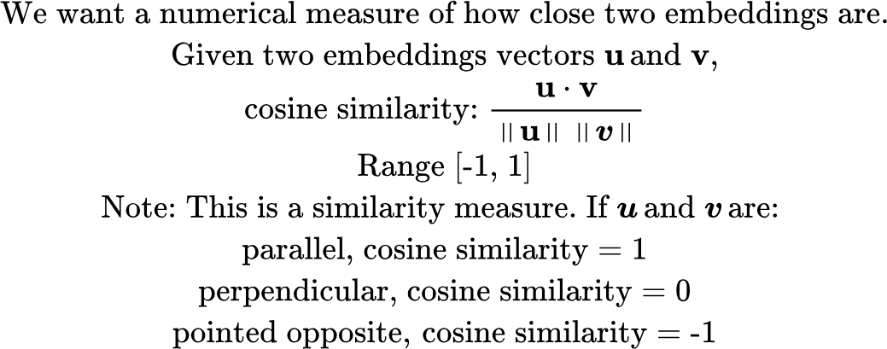
Similarity measures for embeddings

Slide 7
Computing word embeddings: word2vec
Core ideas:
Take a large corpus of text (eg., wiki dump) and create a vocabulary.
Vocabulary can be created simply by converting each word to lower-case and retaining N most frequent words (N ~ 50,000). We maintain an map of each vocabulary word to its index (which acts as a token) and the inverse map. Corpus words that don’t map to any vocabulary word are replaced by an “UNK” token
Learn a d dimensional vector for each word, such that words that occur in similar contexts have similar vectors. “You shall know a word from the company it keeps”
Create (center, context) words using a sliding window of width W:
For each position i with center word wi, context words = words within the distance W, excluding wi
Example for W=2. “quick brown fox jumps over”.
Center word: fox
Pairs: (fox, quick), (fox, brown), (fox, jumps), (fox, over)
word2vec paper

Slide 8
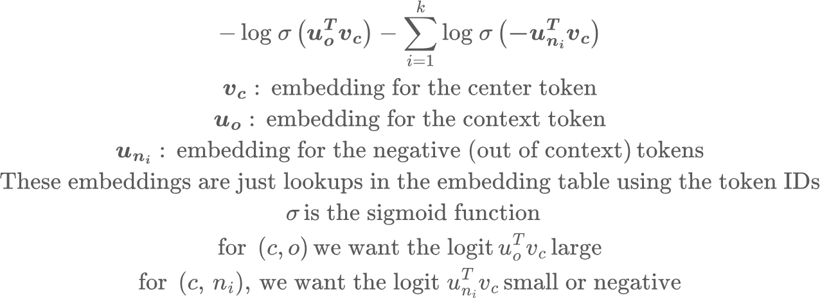
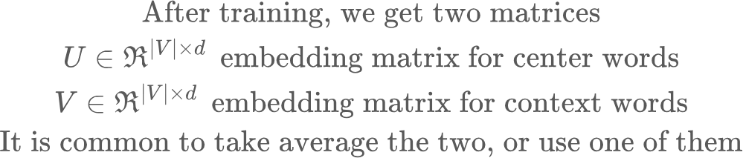
Computing word embeddings: word2vec
Core ideas:
Negative Sampling: draw k negative words, i.e., words not in the context
Hard negative mining: Instead of drawing negative words at random, you can pick hard negatives, i.e., words the model mistakenly thinks are similar to the context word
Maintain two trainable embedding matrices U, V; each V, d (embedding dimension)
Minimize the objective:

Slide 9
Computing word embeddings: word2vec

Slide 10
Training a simple word2vec on text8 dataset
Results of training a simple word2vec algorithm on the text8 dataset (~17M tokens, vocab 50K. Tokens not found in vocab are mapped to a special UNK token.
Neighbors for 'king':
vii (cos=0.535)
son (cos=0.523)
james (cos=0.511)
viii (cos=0.505)
prince (cos=0.496)
Neighbors for 'queen':
elizabeth (cos=0.604)
mary (cos=0.520)
monarch (cos=0.520)
crown (cos=0.514)
majesty (cos=0.497)
Neighbors for 'san':
francisco (cos=0.619)
jose (cos=0.607)
diego (cos=0.522)
california (cos=0.511)
santa (cos=0.488)
word2vec_sgns_embeddings.pt

Slide 11
Creating vocabularies
Recall that the embedding matrices are size (V, d). The number of words in a natural language such as English can be very large. How do we represent such a large number of words in a vocabulary of tractable size?
In word2vec, we simply truncated less frequent words.
In fasttext, a word is broken into character n-grams:
playing: <pl, pla, lay, ayi, yin, ing, ng>, <playing>.
lay: <la, lay, ay>, <lay>
Embedding for a word is the sum of the embeddings for its component n-grams. This way, even an unknown word, not seen during training will have some overlapping n-grams with known words
The underlying training objective doesn’t care if a token is a word, a character, a BPE subword, or something else. The key is: define a tokenization scheme → treat tokens as items in a sequence → run skip-gram/CBOW.

Slide 12
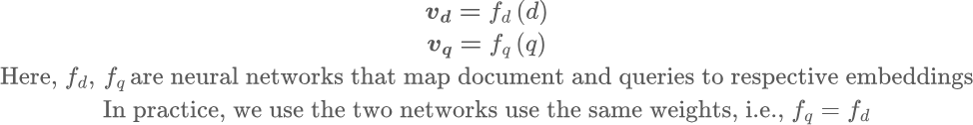
Creating Sentence Embeddings
Word2vec and its variants, produces embeddings for individual words. Our goal is to get embeddings for query and corpus docs.
Technique 1: We could simply take a weighted average of the embeddings of words in a sentence, with the BM25 scores as weights
Technique 2: Dual encoder systems

Slide 13
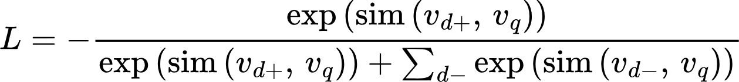
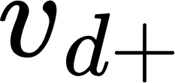
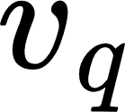
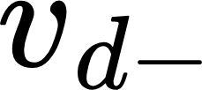
Creating Sentence Embeddings
d+
Encoder
Similarity
query
Encoder
Contrastive Loss
Similarity
d-
Encoder
During training, we consider a batch of (q, d+) pairs. For every query, all documents other than its d+ are treated as d-. This technique (called in-batch negatives) is much more efficient than sampling separate negatives for each d+

Slide 14
Dense retrieval pipeline
For each document in the corpus, compute embeddings. Store embeddings in a vector database (more on this later)
At query time, compute query embedding
Find nearest neighbors
Brute force search against every corpus embedding
Approximate Nearest Neighbor search (precision/recall trade-off)

Slide 15
Story so far..
 | Lexical (TF-IDF, BM25) | MinHash, LSH | Dense retrieval (embeddings)
Pros | Simple and interpretable, works well with rare words. No training needed | Great for near-duplicate detection | Captures meaning, synonyms, paraphrases
Cons | Not based on meaning, hence doesn’t handle synonyms. Struggles if query uses different vocabulary than corpus | Not based on meaning | Requires training + indexing. Can miss critical, rare items (absent from training dataset or infrequently occurring)
In modern systems, we often combine BM25 and dense retrieval: lexical for precision on rare terms, dense for semantics.

